Slide 1
ICT Accessibility and Assistive Technologies Provisions of the Convention on the Rights of Persons with Disabilities
By Axel Leblois
Executive Director, G3ict
EDICT2010: Enabling Access to Education through ICT
New Delhi
27 October 2010
Notes:
BILL & ARTHUR

Slide 2
G3ict Mission
“To Facilitate the Implementation of the Digital Accessibility Agenda Defined by the Convention on the Rights of Persons with Disabilities”
A Flagship Advocacy Initiative of the
United Nations
Global Alliance for ICT and Development
Notes:
AXEL

Slide 3
What is unique about the Convention?
Both a development and a Human Rights instrument
A policy instrument which is cross-disability and cross-sectoral
A Treaty which is legally binding
http://www.un.org/disabilities

Slide 4
Accessibility in the Convention on the Rights of Persons with Disabilities
Preamble (v):
“Recognizing the importance of accessibility to the physical, social, economic and cultural environment, to health and education and to information and communication, in enabling persons with disabilities to fully enjoy all human rights and fundamental freedoms”.

Slide 5
The Pervasive Impact of ICTs on All Aspects of Life
A Massive Increase in ICT usage:
  1.2 billion personal computers
  1.6 + billion Internet users (incl. shared / mobile access)
  1.4 billion telephone land lines
  2.4 billion TV sets and 2.4 billion radios
  5 billion cell phones, over 2 billion text messaging users
Major impact of ICT accessibility on education, economic, government relations and cultural opportunities
Notes:
5
AXEL

Slide 6
Accessibility : ICTs On Par with Physical Environment & Transportation
« To enable persons with disabilities to live independently and participate fully in all aspects of life, States Parties shall take appropriate measures to ensure to persons with disabilities access, on an equal basis with others, to the physical environment, to transportation, to information and communications, including information and communications technologies and systems... » (Article 9)
Notes:
6
AXEL

Slide 7
Dispositions with Implications for ICT Accessibility and Assistive Technologies
Application Areas | CRPD Article | Accessibility dispositions with implications for ICTs | Reasonable Accommodation | Promoting Assistive Technologies
Non discrimination | 5 |  | ü
E-Government | 9.2.a | ü
Media and Internet | 9.1, 9.2.g | ü
Television | 30.1.b | ü
Private Sector Services | 9.2.b | ü
Liberty and Security | 14 |  | ü
Living independently | 19 |  |  | ü
Education | 24 | ü | ü | ü
Employment | 27 | ü | ü
Political Rights | 21, 29 | ü |  | ü
Emergency services | 9.1.b, 11 | ü
Culture & Leisure | 30.5.c | ü
Personal Mobility | 20 |  |  | ü
Rehabilitation | 2 |  |  | ü
Notes:
7

Slide 8
Reasonable Accommodation Defined and Mandated
“Reasonable accommodation” means necessary and appropriate modification and adjustments not imposing a disproportionate or undue burden, where needed in a particular case, to ensure to persons with disabilities the enjoyment or exercise on an equal basis with others of all human rights and fundamental freedoms (article 2)
General obligation and condition for non-discrimination
Referenced in articles on education and employment

Slide 9
Article 24 on Education – Dispositions on Alternative Communications
Facilitating the learning of Braille, alternative script, augmentative and alternative modes, means and formats of communication and orientation and mobility skills, and facilitating peer support and mentoring;
Facilitating the learning of sign language and the promotion of the linguistic identity of the deaf community;
Ensuring that the education of persons, and in particular children, who are blind, deaf or deafblind, is delivered in the most appropriate languages and modes and means of communication for the individual,
Employing teachers, including teachers with disabilities, who are qualified in sign language and/or Braille, and to train professionals and staff who work at all levels of education.
Training shall incorporate disability awareness and the use of appropriate augmentative and alternative modes, means and formats of communication, educational techniques and materials to support persons with disabilities.

Slide 10
Special Dispositions Promoting Accessible & Assistive Technologies
Mandate to promote R&D
ICT Product Development and Universal Design
Obligation for States to set accessibility standards
Intellectual property rights
Promoting New Media and the Internet for Persons with Disabilities
Notes:
1 - Promoting R&D for Assistive Technologies
State Parties...undertake or promote research and development of, and to promote the availability and use of new technologies, including information and communications technologies, mobility aids, devices and assistive technologies, suitable for persons with disabilities, giving priority to technologies at an affordable cost (Article 4 – g)
2 - ICT Products Development
Early Stage Accessibility Definitions:
“Promote the design, development, production and distribution of accessible information and communications technologies and systems at an early stage, so that these technologies and systems become accessible at minimum cost” (Art. 9)
Universal Design:
“To undertake or promote research and development of universally designed goods, services, equipment and facilities, as defined in article 2 of the present Convention, which should require the minimum possible adaptation and the least cost to meet the specific needs of a person with disabilities, to promote their availability and use, and to promote universal design in the development of standards and guidelines” (Art. 4)
3 - Reasonable Accommodation Defined and Mandated
“Reasonable accommodation” means necessary and appropriate modification and adjustments not imposing a disproportionate or undue burden, where needed in a particular case, to ensure to persons with disabilities the enjoyment or exercise on an equal basis with others of all human rights and fundamental freedoms (article 2)
General obligation in article 3, referenced in articles on education and employment
4 – Standards
« States Parties shall take…appropriate measures to develop, promulgate and monitor the implementation of minimum standards and guidelines for the accessibility of facilities and services open or provided to the public »
Article 9-2 (a)
5 - Intellectual Property Rights
“States Parties shall take all appropriate steps, in accordance with international law, to ensure that laws protecting intellectual property rights do not constitute an unreasonable or discriminatory barrier to access by persons with disabilities to cultural materials.”
(Article 30 on Cultural life)
6 - Promoting New Media and the Internet for Persons with Disabilities
« States Parties shall also take appropriate measures to…promote access for persons with disabilities to new information and communications technologies and systems, including the Internet » Article 9 (g)

Slide 11
Measuring Progress: G3ict Report on CRPD Implementation – Country Survey
Argentina
Austria
Bangladesh
Belgium
Brazil
Burkina Faso
Canada
Chile
China
Costa Rica
Denmark
El Salvador
France
Germany
Guinea
Hungary
India
Kenya
Mali
Mexico
Morocco
Nicaragua
Portugal
Rwanda
South Africa
Spain
Thailand
Tunisia
Uganda
United Kingdom
United States
Zambia
Those 31 countries (US excluded) represent 75% of the population of the 90 ratifying countries as of 9-1-2010 (4.9 billion)
Notes:
11

Slide 12
General Legal and Regulatory Framework: Progressive Alignment with CRPD
91% have a constitutional article, law or regulation defining the rights of persons with disabilities
72% have a definition of "Reasonable Accommodation" included in any law or regulation regarding the Rights of Persons with Disabilities
56% have a definition of accessibility that includes ICTs or electronic media in the country laws or regulations
Notes:
12

Slide 13
State Parties with ICT Accessibility Policies in Specific Areas: Education Leads
78% Primary and secondary education
72% Higher education
63% Rehabilitation services
59% Health services
59% Reasonable accommodation at work
50% Emergency services
44% Voting systems
44% Judicial information & legal proceedings
38% Community services
34% Independent living
Notes:
13

Slide 14
Capacity to Implement Is Still Limited
97% have a government body specifically dedicated to Persons with Disabilities, BUT:
41% define, promote an monitor accessibility standards for ICTs
38% have government funds allocated to programs in support of Digital Accessibility
28% have a systematic mechanism to involve DPOs working in the field of digital access to the drafting, designing, implementation and evaluation of laws and policies
13% have statistics or data accessible for the general public about digital access by persons with disabilities
9% have mandatory training programs (at universities, vocational schools etc.) for future professionals about digital access for persons with disabilities (Tunisia, Hungary, South Africa)
Notes:
14

Slide 15
Opportunities
CRPD Framework effective and being adopted universally
Solutions for education exist and are being implemented in multiple countries
New technology will continue to lower costs and improve
Standards development
International cooperation and best practices sharing

Slide 16
International Cooperation on ICT Accessibility – G3ict Programs
Global network of volunteer experts from the private sector, DPOs, international institutions and governments
Knowledge sharing platform: www.g3ict.org
E-Accessibility Policy Toolkit for Persons with Disabilities (with ITU): www.e-accessibilitytoolkit.org
Capacity building programs in cooperation with international institutions (UNDESA, ITU, UNESCO, UNESCAP, World Bank), governments, academia
Books and publications
Research

Slide 17
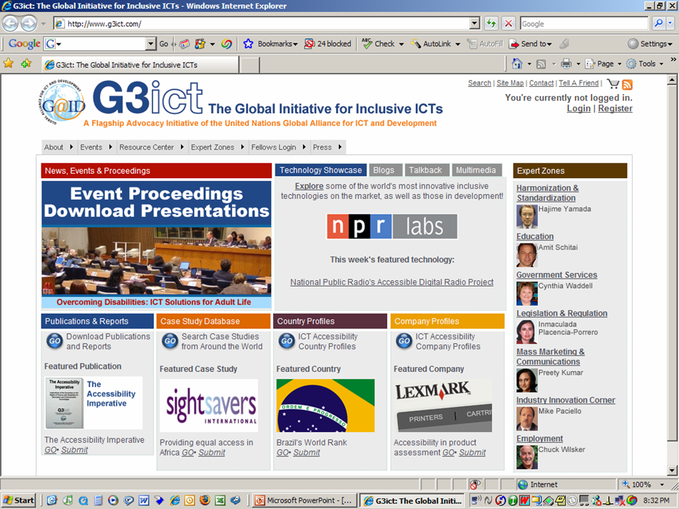
Notes:
17

Slide 18
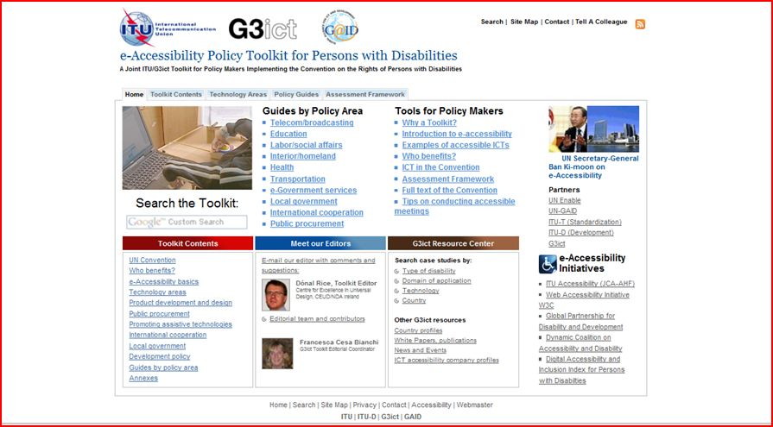
G3ict – ITU Toolkit for Policy Makers

Slide 19
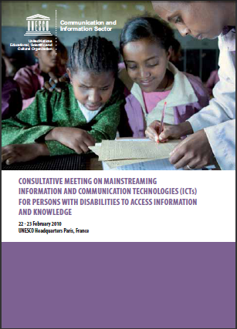
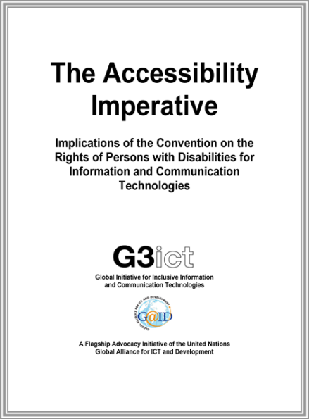
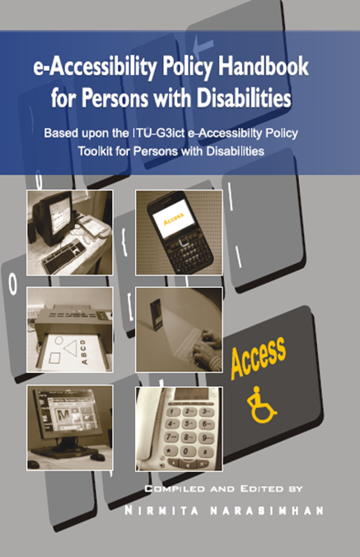
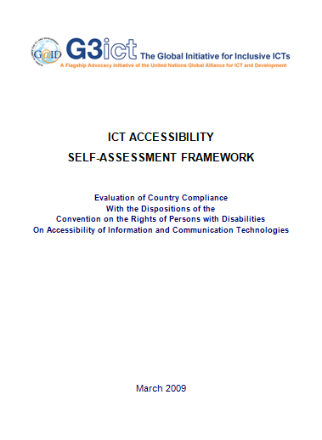
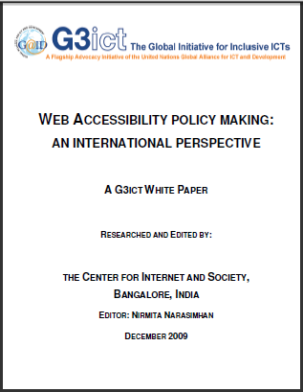
Books and Publications
New Delhi Launch October 27, 2010:

Slide 20
Thank You
www.g3ict.org
www.e-accessibilitytoolkit.org
axel_leblois@g3ict.org
+1 (404) 641 5661
Notes:
20
20
BILL, ARTHUR, AXEL & ASSEMBLED PARTICIPANTS

Slide 21
CRPD References
On Special Dispositions
Promoting Accessible and Assistive ICTs

Slide 22
1 - Promoting R&D for Assistive Technologies
State Parties...undertake or promote research and development of, and to promote the availability and use of new technologies, including information and communications technologies, mobility aids, devices and assistive technologies, suitable for persons with disabilities, giving priority to technologies at an affordable cost (Article 4 – g)

Slide 23
2 - ICT Products Development
Early Stage Accessibility Definitions:
  “Promote the design, development, production and distribution of accessible information and communications technologies and systems at an early stage, so that these technologies and systems become accessible at minimum cost” (Art. 9)
Universal Design:
  “To undertake or promote research and development of universally designed goods, services, equipment and facilities, as defined in article 2 of the present Convention, which should require the minimum possible adaptation and the least cost to meet the specific needs of a person with disabilities, to promote their availability and use, and to promote universal design in the development of standards and guidelines” (Art. 4)
Notes:
23
AXEL

Slide 24
3 - Standards
« States Parties shall take…appropriate measures to develop, promulgate and monitor the implementation of minimum standards and guidelines for the accessibility of facilities and services open or provided to the public »
Article 9-2 (a)

Slide 25
4 - Intellectual Property Rights
“States Parties shall take all appropriate steps, in accordance with international law, to ensure that laws protecting intellectual property rights do not constitute an unreasonable or discriminatory barrier to access by persons with disabilities to cultural materials.”
(Article 30 on Cultural life)

Slide 26
5 - New Media and the Internet
« States Parties shall also take appropriate measures to…promote access for persons with disabilities to new information and communications technologies and systems, including the Internet »
Article 9 (g)

