Slide 1
Connecting Schools: Global Challenges and Solutions
EDICT2010: Enabling Access to Education through ICT
Shifting Paradigms for Accessible and Assistive Solutions: Can India’s Schools Leapfrog Current Solutions?
India Habitat Centre, New Delhi, India
Wednesday 27 October 2010
Susan Schorr
Head, Special Initiatives Division,
TELECOMMUNICATION DEVELOPMENT BUREAU (BDT)
Notes:
Ladies and gentleman it’s a pleasure to be here in the session on Shifting Paradigms for Accessible and Assistive Solutions: Can India Schools Leapfrog Current Solutions?

Slide 2
PRESENTATION OUTLINE
2
ITU’s role in promoting connected schools
Connect a School, Connect a Community initiative
Global Challenges to Connecting Schools for ITU Members
Solutions for School Connectivity
ITU’s role in promoting accessible ICTs
Challenges to Connecting Schools for Persons with Disabilities
Connect a School, Connect a Community Toolkit Module on Using ICTs to Promote Education and Job Training for Persons with Disabilities
Notes:
2
In this presentation, I would like to discuss:
ITU’s role in promoting connected schools
introduce you to the Connect a School, Connect a Community initiative
Identify some of the Global Challenges to Connecting Schools in general, and how they apply to ITU Members
Some of the solutions for School Connectivity we’ve identified
ITU’s role in promoting accessible ICTs
Dig down into some of the Challenges to Connecting and Equipping Schools for Persons with Disabilities
Introduce you to the Connect a School Module on Using ICTs to Promote Education and Job Training for Persons with Disabilities

Slide 3
ITU’s Role in Promoting Connected Schools
Connect a School, Connect a Community Initiative
Development of a Toolkit of Best Practices and Policy Advice
Repository of Training Materials for Connected Schools
National Projects to develop National School Connectivity Plans
Notes:
ITU has three distinct sectors: Radio Communication, Standardization and Development. I work in the Development Sector in the Special Initiatives Division. Our mandate is to promote ICT access and use for the social and economic development of children and youth, indigenous peoples, persons with disabilities and women and girls.
Given this rather large mandate and limited resources, we decided to try to build synergies between the different people with special needs by focusing on connecting schools. We figured if we could encourage ITU member states (ministries of communication and national telecom regulatory authorities) to promote school connectivity, we would help tackle the issue of ICT access and use by youth and children.
Then, if we could encourage the connected schools to be used as community ICT centres, these could be designed to meet the needs of women, indigenous peoples and persons with disabilities.
We launched Connect a School at the 2009 ITU Youth Forum where the UN Secretary General came to endorse it and encourage the other UN Agencies to work with us.
Since that time, we’ve developed an online toolkit of best practices, a repository of training materials for connected schools and have begun working with countries to help them develop national school connectivity plans.

Slide 4
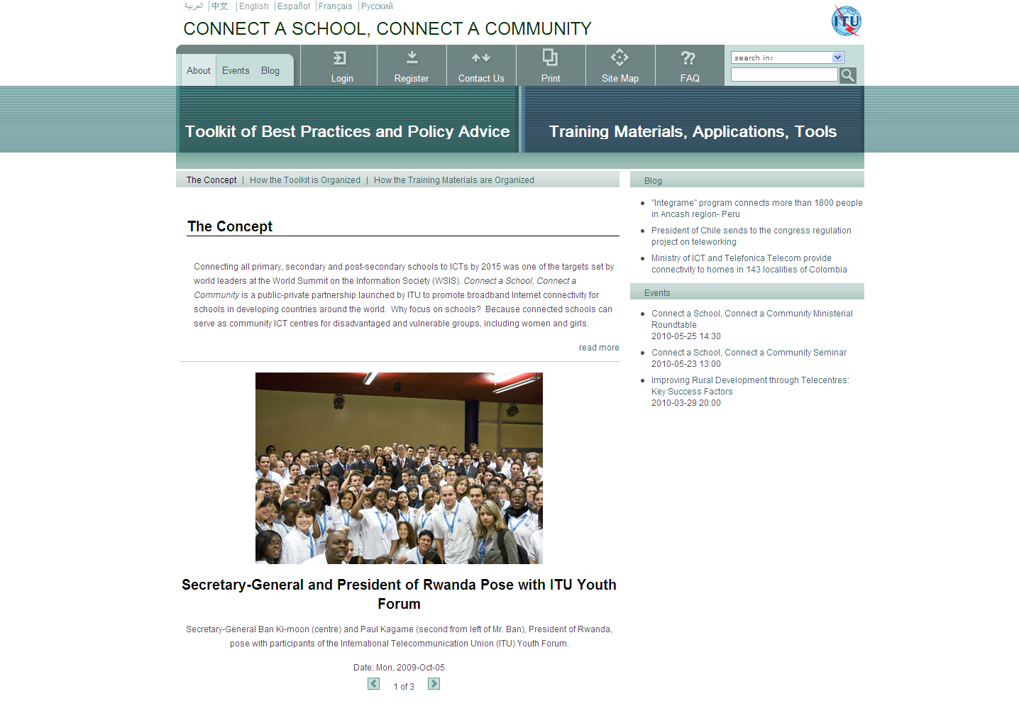
www.connectaschool.org
Notes:
Here is a screen shot of the Connect a School, Connect a Community toolkit and repository of training materials, including a picture of the launch with Ban Ki-moon.
Currently we have 4 published modules in the toolkit:
One on best practices on policies and regulations to promote school connectivity,
Two, on the use of low cost computing devices in schools.
Three, designing community ICT centres for indigenous peoples
Four, using ICTs to promote education and job training for persons with disabilities.
Sometime this week or next week the fifth module on ICT community centres for women’s empowerment will also go live.

Slide 5
Global Challenges to Connecting Schools for ITU Members
Who pays for Broadband Internet Connectivity?
Which schools get connected?
Who pays for ICT equipment?
How to leverage connected schools to serve the greater community?
How to ensure sustainability?
Notes:
The development of the content for this toolkit required massive research and analysis.
It has also identified some of the major global challenges to connecting schools that could be addressed by ITU Members.
Our goal in developing the first two modules of the toolkit was to identify clear steps our Member States could take to start connecting schools in their countries now.
So what are the issues.
Who will pay for broadband connectivity? Internet service providers? Telecom operators? School Districts? Universal service funds? Departments of education?
Which schools should be connected? Top down approach, bottom up approach or hybrids
Who pays for the ICT user equipment?
How to leverage the connected schools to serve the greater community?
How to ensure sustainability?

Slide 6
Solutions to School Connectivity
Develop national school connectivity plans identifying timelines for connecting schools and connectivity funding options:
  Require operators to connect schools in their 3G licenses
  Provide spectrum for WiMax in exchange for connectivity for schools
  Require operators to provide low cost tariffs to schools
  Allocate spectrum for schools
  Reserve fibre stands for public institutions
  Fund school connectivity through universal service funds
Leverage connected schools into community ICT centres serving the local community
Ensure teacher training and maintenance
Notes:
These are some big challenges! The good news is a growing number of countries have already tackled these challenges. There are a range of options for those countries that have not yet tackled the problems.
The main solution is to build political will to systematically and holistically connect schools and to develop plans addressing the key challenges. We are calling these National School Connectivity Plans.
NSCPs can identify the schools to be connected, establish a timetable for connecting schools, identify funding sources, technological options, sustainability and the national ICT laws, policies, Master Plans and regulations required to foster school connectivity as well as the role of all stakeholders.
Take funding, there are a variety of options countries are taking. Brazil is requiring its 3G operators to connect urban schools as a license condition. Some countries are considering providing free spectrum for WiMax in exchange for connecting schools. Others use low-cost tariffs for schools and provide subsidies for schools in their universal service funds. The US has allocated spectrum for broadband connectivity for schools. Some fibre backbone operators provide free fibre strands to government buildings, including schools, in exchange for rights of way to lay their fibre networks.
While Canada is a wealthy country, and Russia is an emerging economy, both have a vast land mass to cover. Yet both have connected all of their schools.
While there are also challenges and solutions related to incorporating ICTs into school curriculum, this is not an issue ITU has addressed since it falls outside our mandate.
Nevertheless, we do encourage teacher training on ICT use and the need for IT training so equipment continues to be maintained.

Slide 7
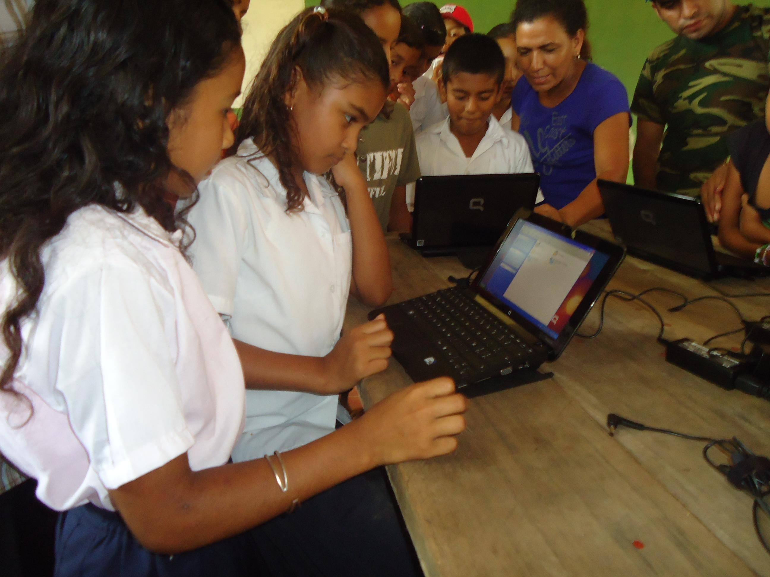
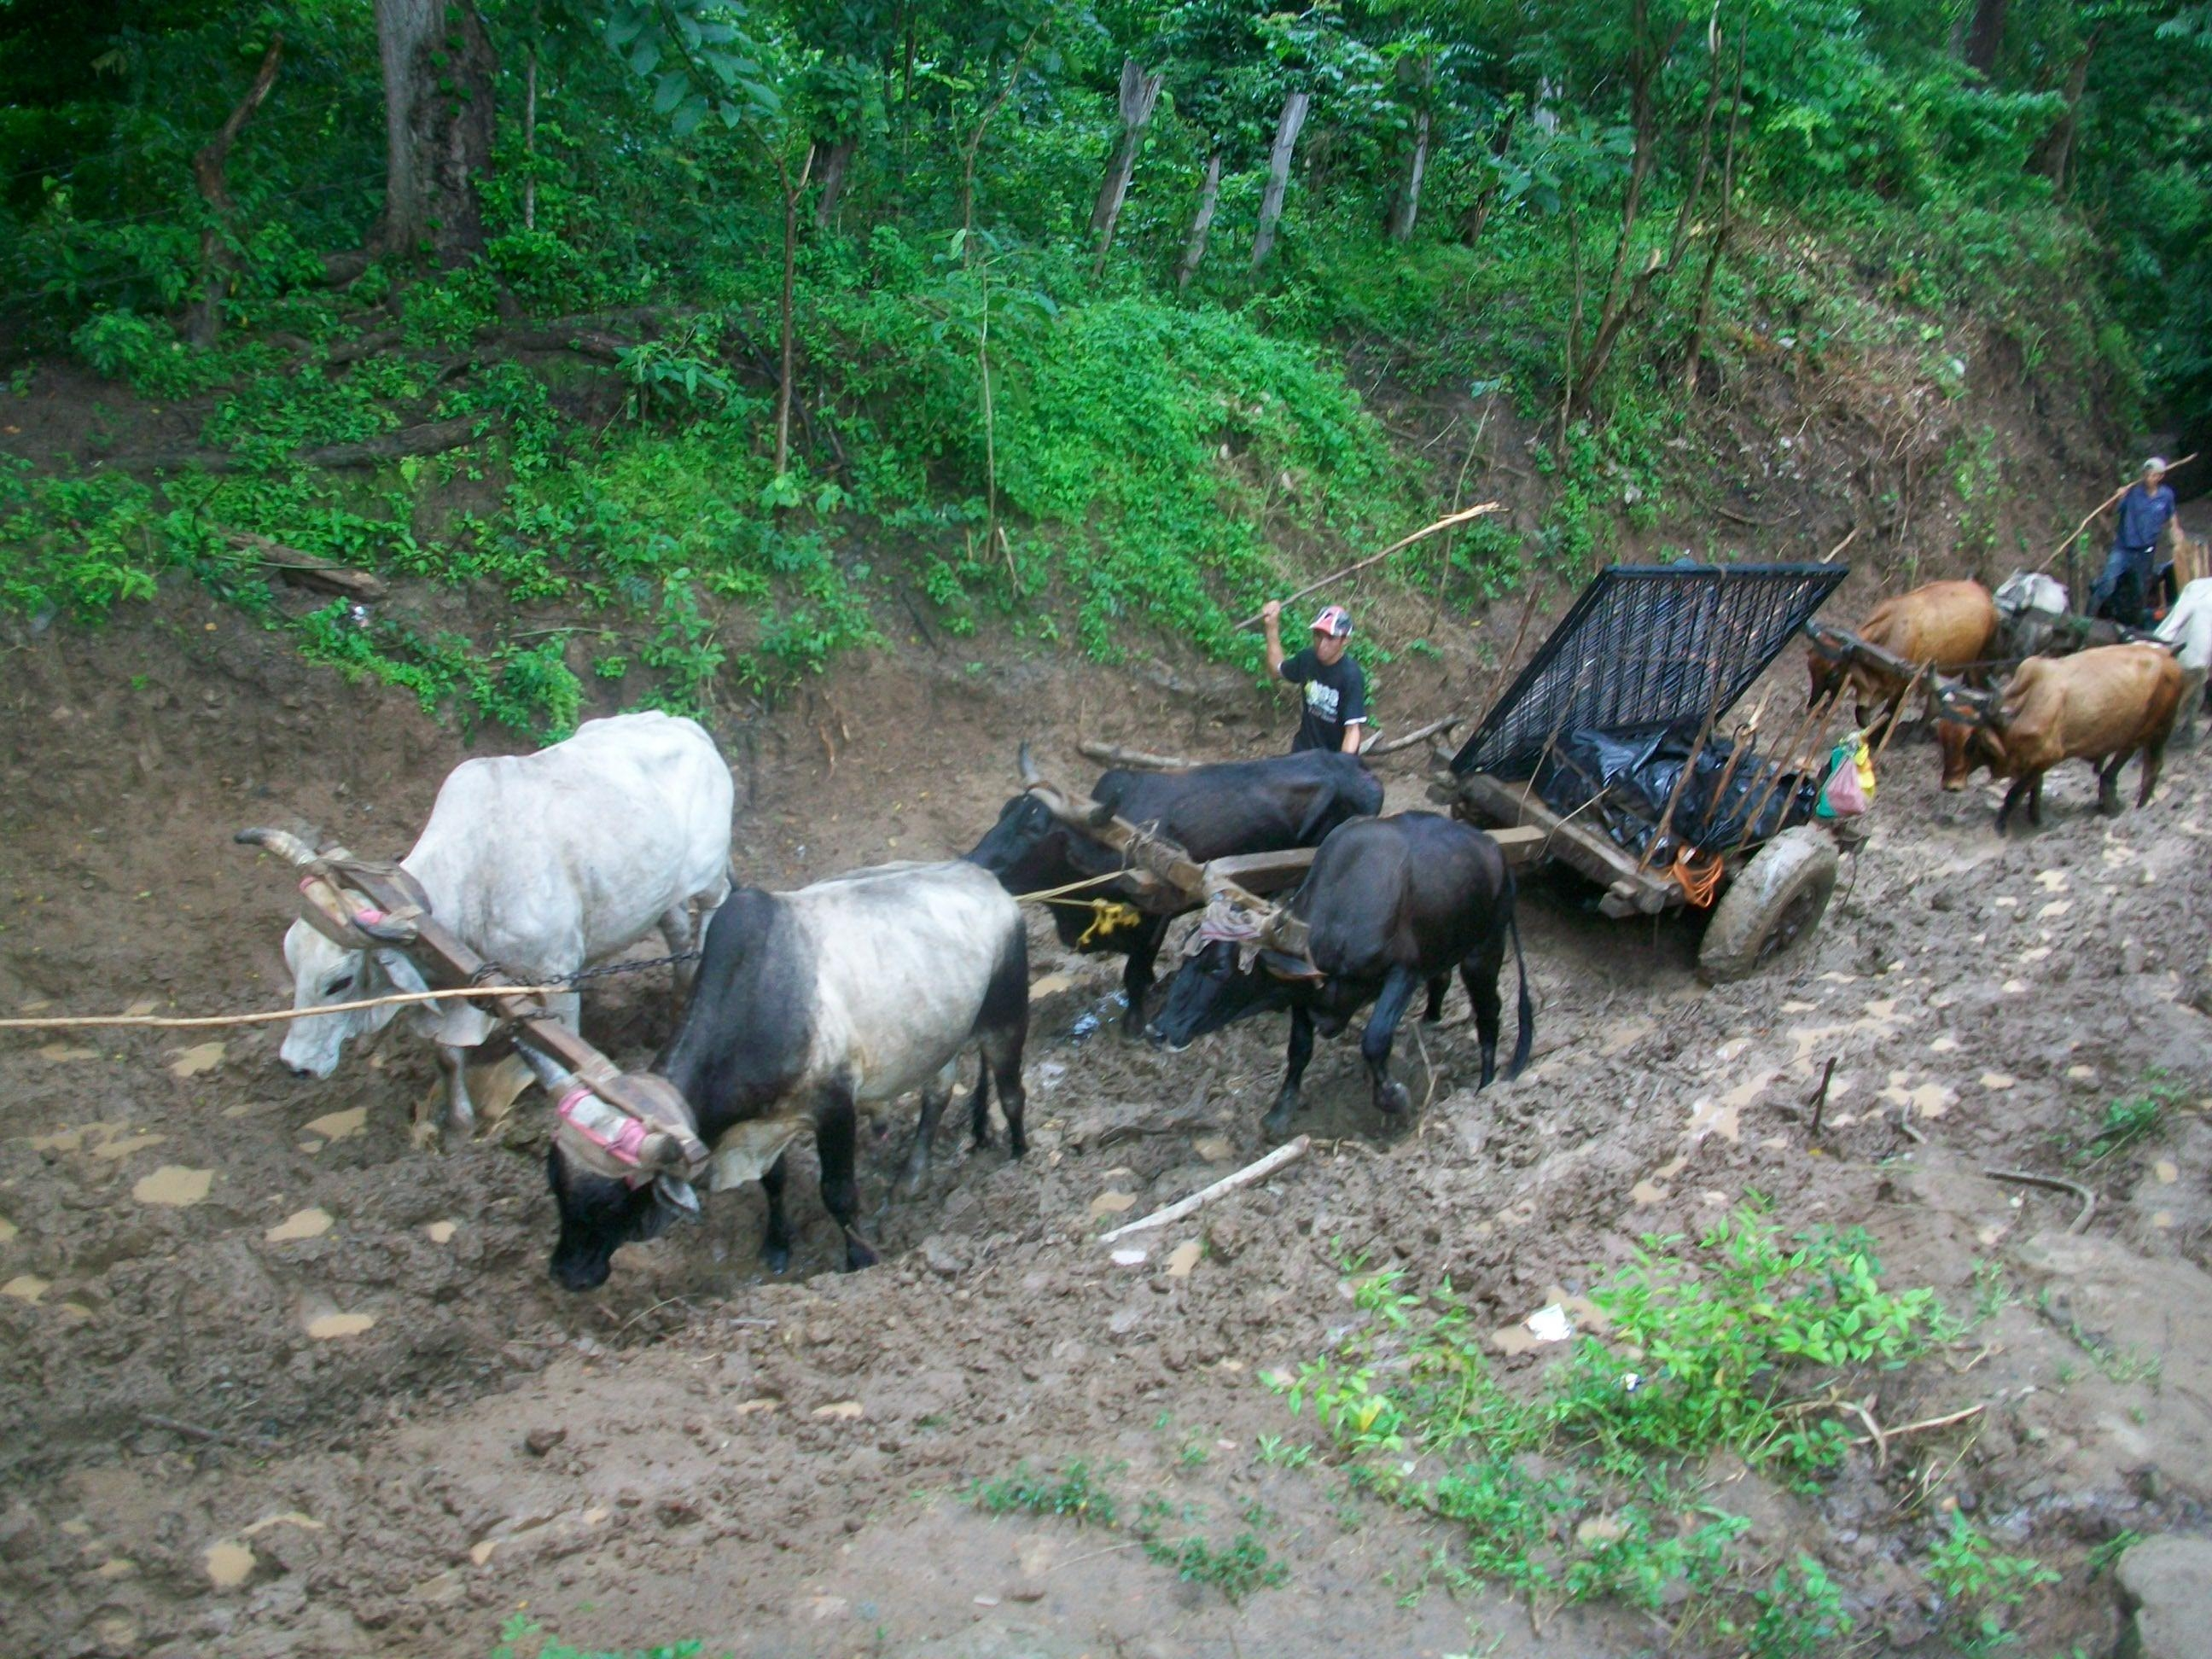
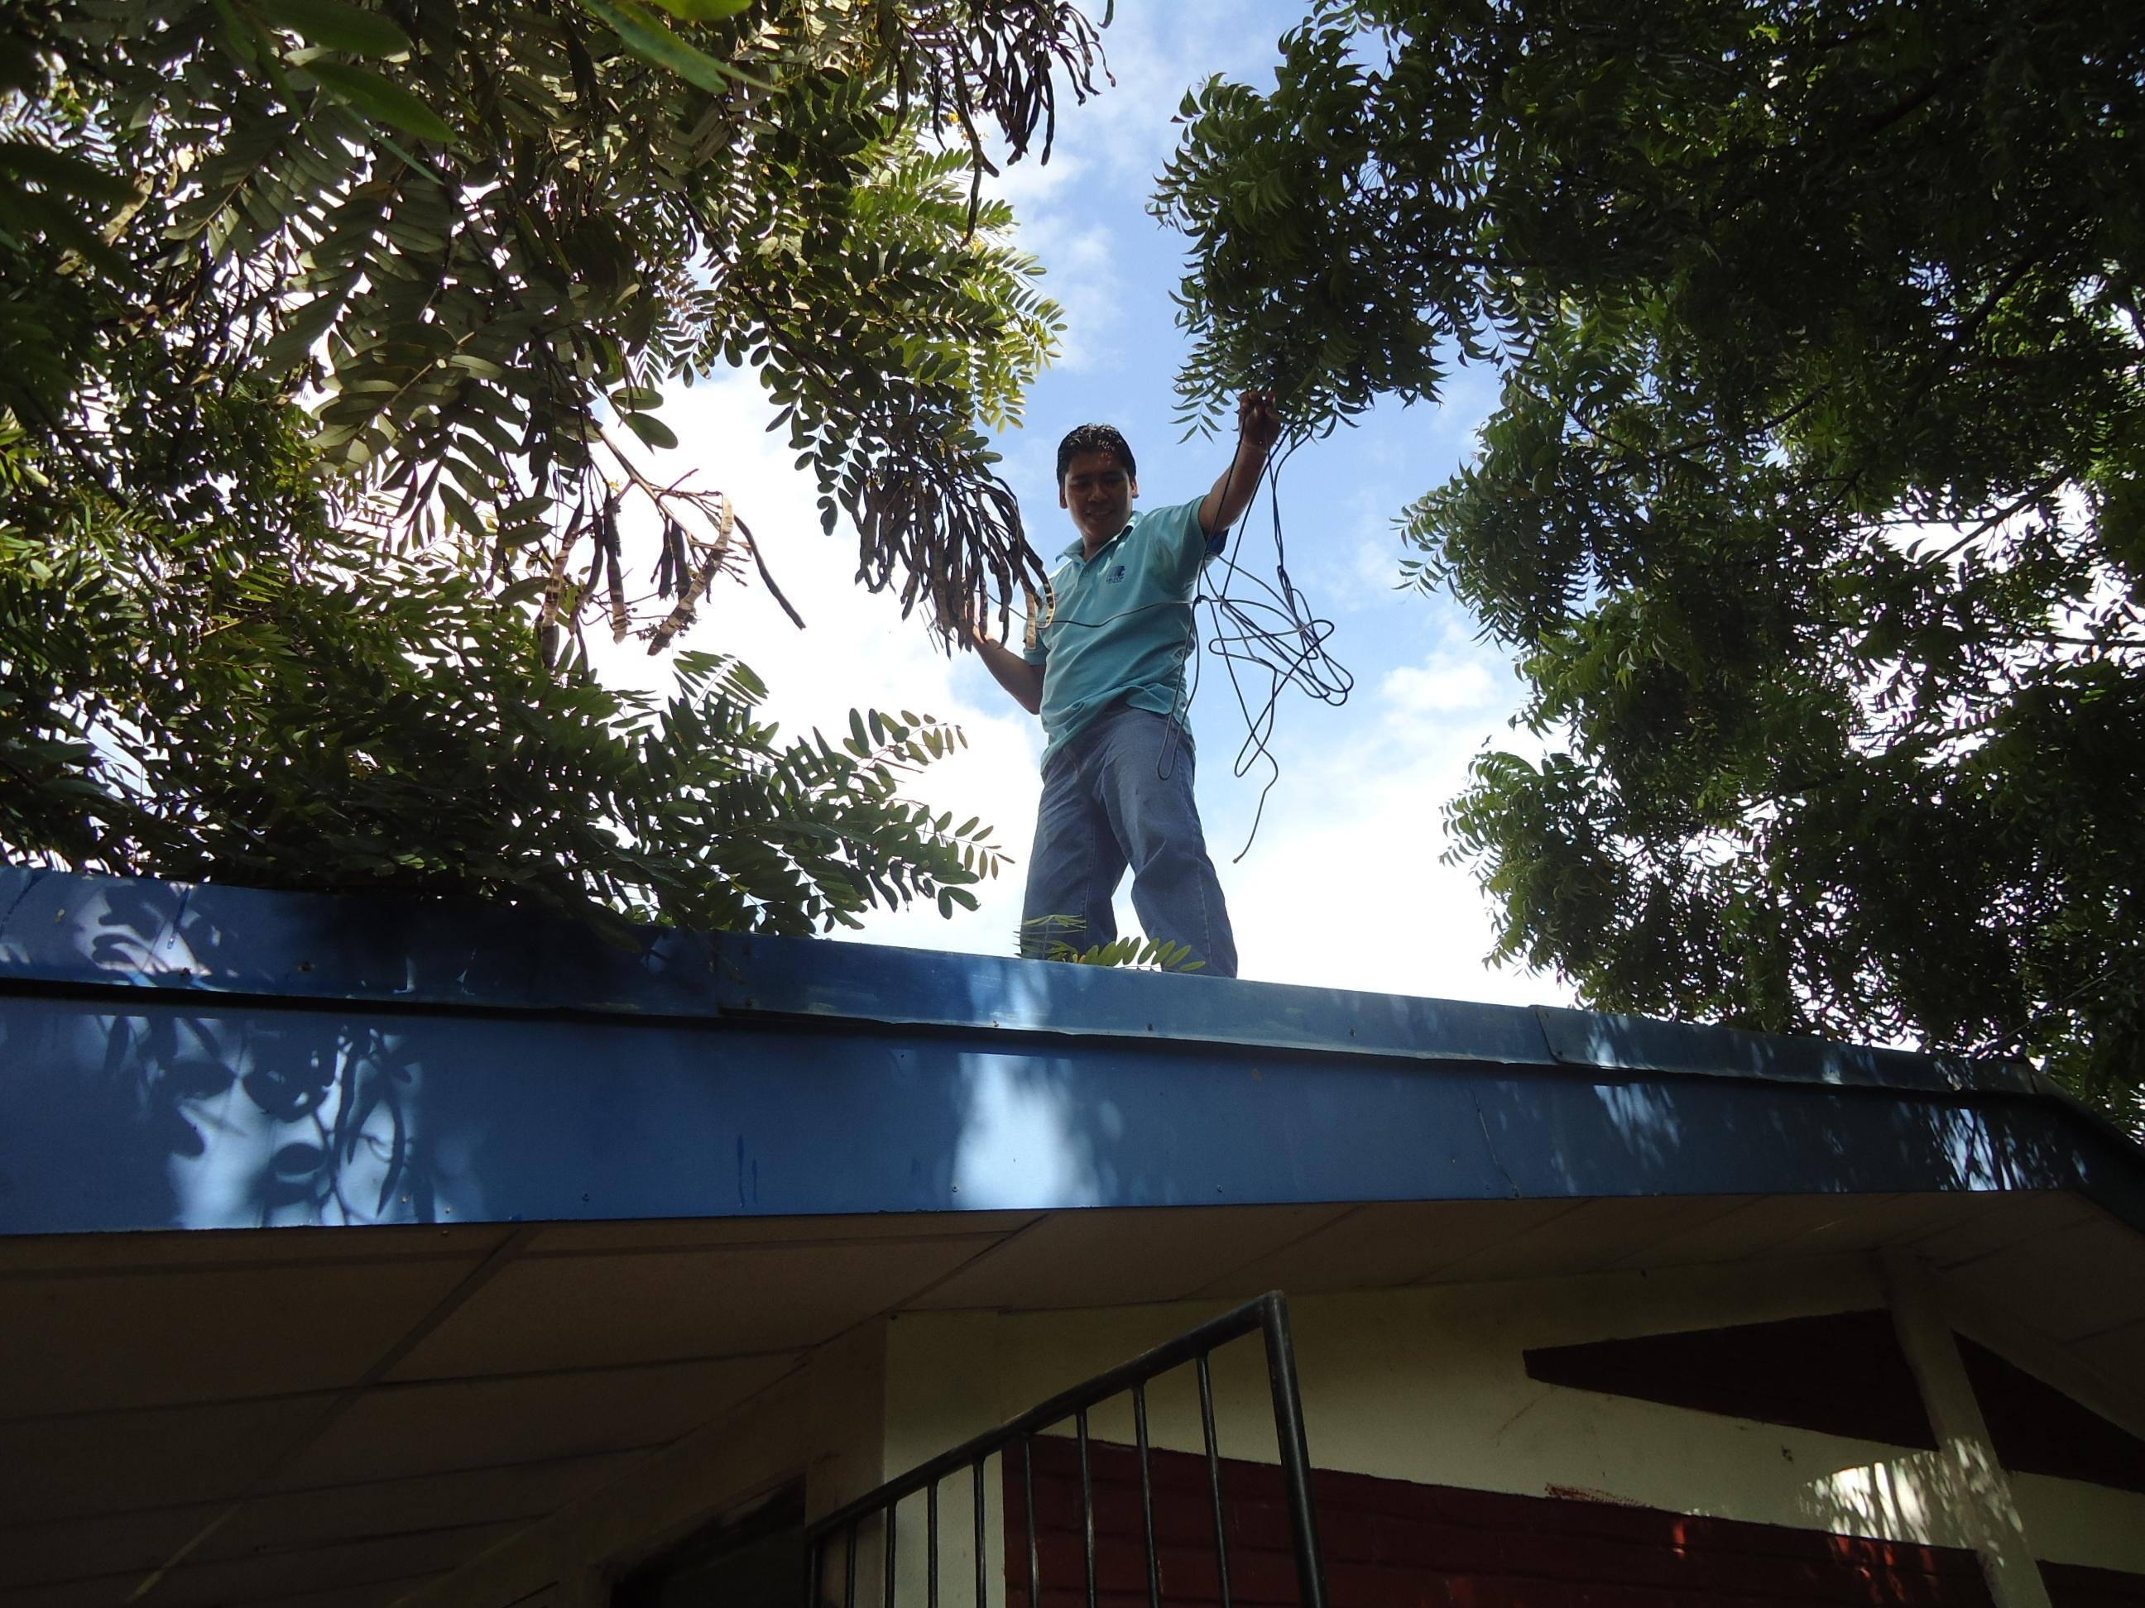
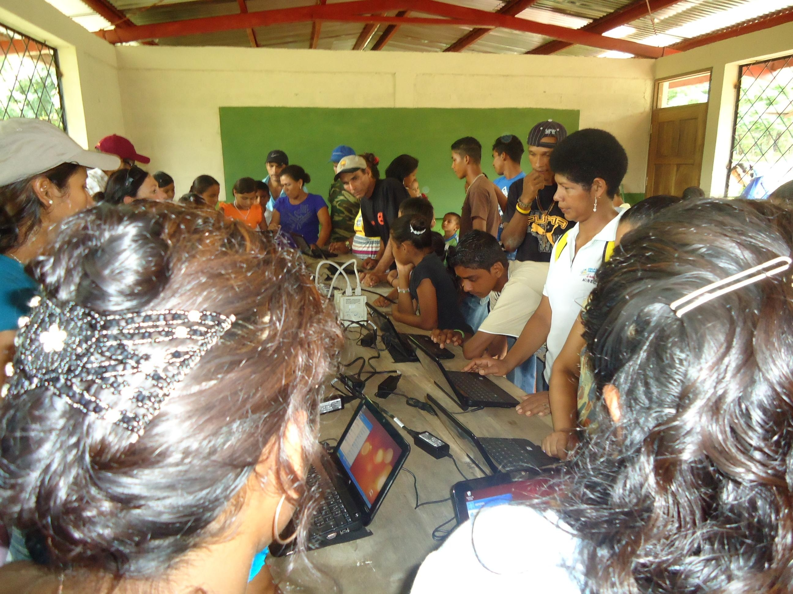
National Projects - Nicaragua
Development of Model Schools
National School Connectivity Plan
Notes:
As I mentioned, we are currently working with a handful of developing countries on national school connectivity plans.
Here are some pictures from our project in Nicaragua.
In order to build political support and demonstrate the importance of connecting schools, we have connected 5 model schools in a range of different locales.
Here you can see the most rural, with the computers being dragged up dirt trails as well as other class rooms where kids are getting to use computers and access the Internet for the first time!

Slide 8
ITU’s Role in Promoting Accessible ICTs
ITU and G3ict developed the e-Accessibility toolkit for Policy Makers
ITU organizes awareness raising seminars and workshops
ITU develops projects in developing countries to create Multi Purpose Community Telecentres (MCTs) equipped with assistive technologies
ITU is developing text-to-speech applications in Mongolian
ITU MCTs for persons with disabilities revealed that adult users often have had no education, are illiterate and have no job skills
  Reason: often a belief that children with disabilities cannot be educated, that adults with disabilities cannot be trained with job skills
  Result: vicious cycle of un-educated, illiterate adults with disabilities unable to become financially secure and independent
Gave rise to the Connect a School, Connect a Community toolkit module on persons with disabilities
Notes:
In addition to Connect a School, ITU has put a lot of effort into promoting accessible ICTs. Again, our strategy is to identify concrete steps our Members can take and provide them with the best practices and resources to use as models.
To this end, ITU and G3ict developed the e-Accessibility toolkit for Policy Makers. The toolkit is designed to assist ITU members to implement the ICT accessibility provisions of the UN Convention on the Rights of Persons with Disabilities.
The toolkit identifies actions ITU members can take to promote accessible ICTs
ITU also develops projects in developing countries to create Multi Purpose Community Telecentres (MCTs) with assistive technologies
ITU is developing text to speech applications in local languages in Mongolia
ITU projects to create Multi Purpose Community Telecentres (MCTs) for persons with disabilities in developing countries revealed that adult users of our MCTs often have had no education, are illiterate and have no job skills
Reason: often a belief that children with disabilities cannot be educated, that adults with disabilities cannot be trained with job skills
Result: vicious cycle of un-educated, illiterate adults with disabilities unable to be financially secure
This gave rise to the development of a module in the Connect a School toolkit on using ICTs to promote education and job training for persons with disabilities.

Slide 9
UNESCO Education Data
90 per cent of children with disabilities in developing countries do not attend school
186 million children with disabilities worldwide have not completed their primary school education
97 per cent of persons with disabilities do not have basic reading and writing skills
Literacy rate for adults with disabilities is as low as 3 per cent and, in some countries, as low as 1 per cent for women with disabilities
Notes:
ITU’s experience in MCTs was confirmed by far more comprehensive studies undertaken by UNESCO and the ILO.
Here we can see some startling UNESCO data.
90% of children with disabilities in developing countries do not attend schools.
186 million have not completed their primary education
97% of persons with disabilities can’t read or write.
Literacy rates for adults with disabilities is as low as 3%, and as low as 1% for women with disabilities in some countries.

Slide 10
ILO Data
ILO estimates that some 470 million people with disabilities are of working age worldwide
However unemployment among the disabled is as high as 80 per cent in some countries
Notes:
Likewise, ILO estimates that unemployment among the disabled is as high as 80% in some countries.
Clearly, in those countries where children with disabilities are denied an education and can’t read or write, getting the kind of job skills needed for today’s Information Society is a challenge.

Slide 11
OUTLINE of Persons with Disabilities Module
Section 1 – Introduction
Section 2 – Current situation, challenges and opportunities
Section 3 – Assistive Technologies (ATs)
Section 4 – Developing and Implementing accessible ICT connected schools
Section 5 – Accessible Multipurpose Community Telecentres in Schools
Section 6 – Checklist for policy makers
Section 7 – International texts on PwDs
Section 8 – Case studies
Section 9 – Resources for teachers and policy makers
11
Notes:
11
We hope that our latest module of the Connect a School, Connect a Community toolkit will help raise awareness for this widespread problem, identify the challenges faced by persons with disabilities and the role accessible ICTs can play in connected schools to break this vicious cycle.
It includes an in-depth discussion on different assistive technologies, issues in developing and implementing accessible ICT connected schools and leveraging such connected schools to create community ICT centres for adults with disabilities.
It includes case studies from a range of countries and useful resources for policy makers.
One of main goals is to encourage ITU Member States to do more to promote the availability of assistive technologies in their markets and to try to raise awareness with their counterparts in education ministries of the role assistive technologies can play to promote inclusive education to change attitudes – where they may exist – that persons with disabilities cannot be educated.
By promoting the availability of accessible ICTs, ITU members can also help drive down costs for such ICTs.

Slide 12
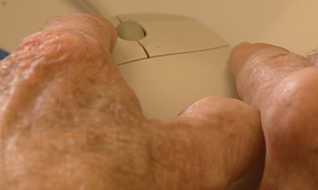
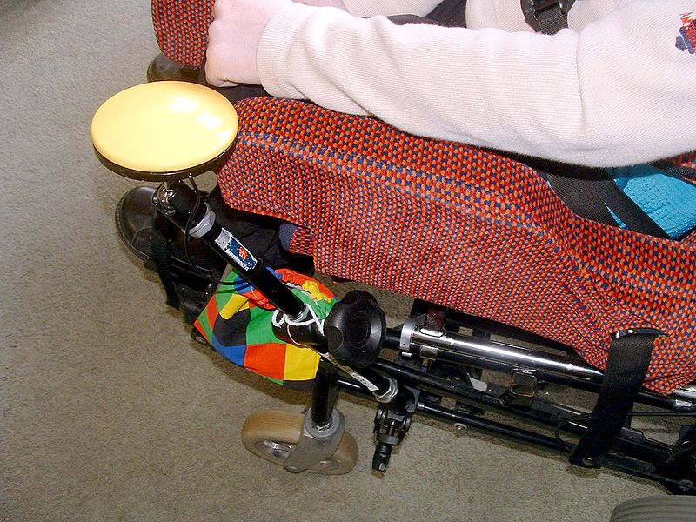
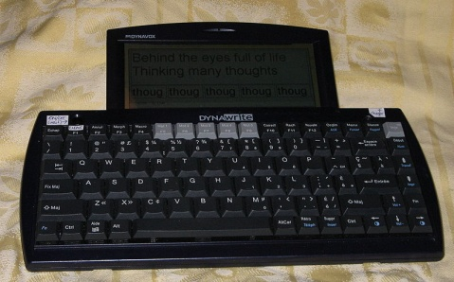
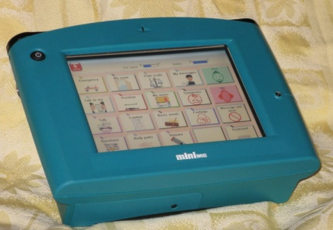
Assistive Technologies: Not one size fits all
An arthritic hand trying to use a standard mouse
A single switch mounted on a wheelchair
Keyboard text-to-speech generating device
Speech generating device
Notes:
Like many of the presentations, the module identifies a number of accessible ICTs and Assistive technologies that can be used by persons with disabilities.

Slide 13
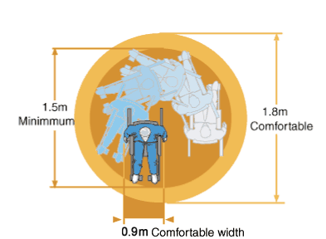
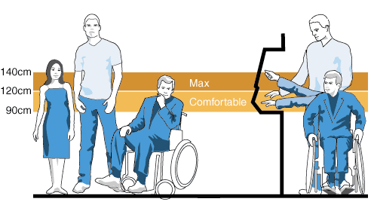
Accessible Buildings and Workstations
Wheelchair clearance and turning circle
Common reach zones
Notes:
It also talks about the need for accessible buildings and workstations.

Slide 14
General benefits of Assistive Technologies
Enables greater learner autonomy
Unlocks hidden potential for those with communication difficulties
Enables students to demonstrate achievement in ways which might not be possible with traditional methods
Enables tasks to be tailored to suit individual skills and abilities
Notes:
It identifies the benefits of assistive technologies in general.

Slide 15
Benefits for students
Computers can improve independent access for students to education
Students with special educational needs are able to accomplish tasks working at their own pace
Visually impaired students using the internet can access information alongside their sighted peers
Students with profound and multiple learning difficulties can communicate more easily
Students using voice communication aids gain confidence and social credibility at school and in their communities
Increased ICT confidence amongst students motivates them to use the internet at home for schoolwork and leisure interests.
Notes:
Then hones in on the benefits for students.

Slide 16
Benefits for teachers and non-teaching staff
Reduces isolation for teachers working in special educational needs by enabling them to communicate electronically with colleagues
Supports reflection on professional practice via online communication
Improved skills for staff and a greater understanding of access technology used by students
Enhances professional development and the effectiveness of the use of ICT with students through collaboration with peers
Materials already in electronic form (for example, from the internet) are more easily adapted into accessible resources such as large print or Braille.
Notes:
Teachers and non teaching staff.

Slide 17
Benefits for parents and carers
Use of voice communication aids encourages parents and carers to have higher expectations of children’s sociability and potential level of participation.
From: BECTA ICT Research (2003) What the research says about ICT supporting special educational needs (SEN) and inclusion. Available at http://research.becta.org.uk/upload-dir/downloads/page_documents/research/wtrs_motivation.pdf
Notes:
And the benefits for parents and carers.
The toolkit also includes a vast array of resources for more information on each of the topics.

Slide 18
Challenges to Connecting Schools for Persons with Disabilities
How to ensure that ICT equipment is accessible for children with disabilities?
How to ensure an inclusive education for children with disabilities?
Cost of inclusive education
Understanding users needs by type of disability
Understanding how many children with disabilities receive an education – or don’t
Reasons for exclusion
Breaking the cycle of un-educated, illiterate persons with disabilities
Need for comprehensive policies
Notes:
Of course, the Connect a School toolkit module identifies a range of challenges to connecting schools for persons with disabilities. These include:
- ensuring that ICT equipment is accessible for children with disabilities so they can benefit from an inclusive education.
- The module also discusses the costs of inclusive versus separate education. This is an issue which seems to require further data collection and analysis.
- It talks about the importance of understanding user needs by type of disabilities, as well as
- how many children with disabilities receive an education --and how many don’t. Once again, our research shows a lack of available data on this vital question.
Another challenge is understanding the reasons persons with disabilities are excluded and how to break the cycle of un-educated, illiterate persons with disabilities.
- just like the challenge of connecting schools, the challenge of ensuring accessible ICTs in schools requires comprehensive policies.

Slide 19
Reasons for Exclusion
Attitudinal
Physical access challenges
No training of teachers
No special transportation
No policy strategy for addressing challenges
Notes:
Each of these challenges is discussed in greater detail, and time does not allow me to cover them all.
Here is an example, however.
The toolkit module identifies a range of reasons children with disabilities in developing countries may be excluded from education.
I’ve already noted the attitudinal reasons we’ve seen. These have been well documented by UNESCO and UNICEF.
Some are more practical issues that require action: ensuring physical access to schools, teacher training, special transportation and again the need for policies to address these challenges.

Slide 20
Cross-Cutting Policy Areas Supporting Accessible ICTs in Connected Schools
Education
Telecommunications
E-government
Finance and public procurement
Import/customs duties and taxation
Welfare and employment
Equality
Notes:
Much of the toolkit module focuses on policy.
To quickly highlight some of this discussion, you will note that the issue of accessible ICTs in connected schools covers a number of cross-cutting policy areas. Not just education, this concerns telecoms, finance, public procurement, import and customs duties, welfare and employment to name some.

Slide 21
Key policy areas for accessible ICTs in schools
Infrastructure – including statistics on numbers of connected schools, computer availability and use and availability of assistive technologies
Support for teachers and students – including from national agencies for ICT in education and access to specialist resource centers
Needs assessment of the person with a disability – that cover the Assistive Technologies (AT) and related supports required to enable a child to receive an education in an inclusive schools environment
Training – including on how to teach children with disabilities and on the use of accessible ICTs
Co-operation/research –the development of a sustainable AT eco-system, including research into the needs and experiences of both learners and teachers and research into the development of new and better AT solutions and service delivery models.
Evaluation – need to monitor implementation of the various policy reforms to evaluate if they provide the support required to achieve the stated goals and to inform further policy intervention.
Notes:
Looking more closely at the policies for schools, we see once again there are a range of issues covering, infrastructure, support for teachers and students, needs assessments, training, research and evaluation.
infrastructure– this includes statistics on connected schools with internet access, number of computers available in schools, availability of assistive technologies, use of computers and other forms of ICTs as pedagogical tools by teachers
Support for practice – closely related to infrastructure, this looks at the range of supports available to teachers and students, from national agencies for ICT in education, to support services that work directly with children and teachers, to in-school supports, to access to specialist resource centers.
Needs assessment of the person with a disability. While systems of needs assessment for children identified as having a disability may already be in place, these need to incorporate a clear statement of needs which cover the ATs and related supports required to enable a child to receive their education in an inclusive schools environment.
Training – a key element of support is in training specific to the teaching of children with disabilities. A key element of that will be the use of accessible ICTs, which includes training during initial teacher training and in-service training. The availability of relevant support and training is often cited by teachers as an area of equal importance to the availability of appropriate hardware and software.
Co-operation/research – a key element to building capacity within a country’s educational system will be the development of a sustainable AT eco-system. This includes on-going research into the needs and experiences of both learners and teachers, sharing of experiences and expertise and research into the development of new and better AT solutions and service delivery models.
Evaluation – implementation of the various policy reforms must be monitored to decide whether they provide the support required to achieve the stated goals and to analyze and interpret the results and inform further policy intervention.

Slide 22
Some Solutions to promote accessible ICTs in schools
Develop National School Connectivity Plans to promote necessary Internet access and that include provision of accessible ICTs
Regulators and policy makers ensure that accessible ICTs are available in the market and that customs duties and taxes remain low
Educators Procure only Accessible ICTs – create demand for accessible ICTs
Equip schools according to need of students
Develop an AT ecosystem
Fund Assistive Technologies through Universal Service Funds
Teacher and Student Training
Conduct stakeholder consultations
Conduct monitoring and evaluation
Development of affordable screen readers in local languages
Use the Connect a School, Connect a Community toolkit to raise awareness and build capacity
Notes:
So what are some of the solutions to these challenges
Accessible ICTs and Assistive technologies will require school connectivity. ITU Member States can help here by enacting National School Connectivity Plans.
ITU Members can also help by ensuring that accessible ICTs are available in national markets.
Finance government officials can ensure that customs duties and taxes for such equipment remain low
Educators can procure only accessible ICTs and create a demand for accessible ICs
Educators will also seek to equip schools according to the needs of students,
Educators will also need to develop an AT ecosystem to ensure that the infrastructure, personnel and products are available. Assessment and support services such as fitting, training and follow up to ensure safe and efficient use is an important part of this ecosystem
Obviously training for teachers and students as well as stakeholder consultations will be necessary
Universal service fund administrators could consider funding assistive and accessible ICTs, including affordable screen readers in local languages
ITU hopes the Connect a School, Connect a Community toolkit will be useful to all government officials in tackling these issues.

Slide 23
Using schools for skills and job training for Adults with Disabilities
Accessible ICTs hold the potential to enable persons with disabilities to receive job skills that would otherwise be inaccessible to them
Sufficient and appropriate training enables persons with disabilities to reach their own personal potential
Toolkit Case studies on job skills training, certification and employment opportunities
Notes:
To come back full circle to Connect a School, the last word on the PwD module is that once equipped with accessible and assistive technologies, schools can be used as community ICT centres to provide much needed job and vocational training for adult persons with disabilities.
The case studies in the Toolkit include many examples of such centres.

Slide 24
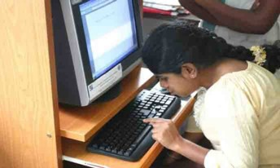
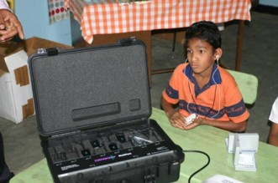
Project: Building Capacity for Harnessing ICTs for Disempowered / Marginalized Communities in Sri Lanka (eNABLE)
ITU Assistance Phase 1 – technical assistance in IT equipment and assistive technologies to 28 centres.
About 2,292 people including students, marginalized people and PwDs have been benefited
ITU Assistance Phase 2 – technical assistance in IT equipment and assistive technologies to 33 schools, 2 universities, 17 vocational training centres, and 17 Ranaviru villages.
About 4,678 people including students, marginalised people and PwDs have been benefited
Notes:
Here’s a slide on another one of our country projects, this one in Sri Lanka using assistive technologies to create community ICT centres for persons with disabilities – including both students and adults.
We have also funded such a centre in Burkina Faso and Ethiopia, and many of our multi purpose community telecentres in Africa benefit from assistive technologies.

Slide 25
Thank You!
For more information:
See the Special Initiatives website at
www.itu.int/ITU-D/sis/
Or contact
sis@itu.int
susan.schorr@itu.int
Notes:
Thank you!

