Slide 1




Project
Claudio Giugliemma
President
© Copyright 2010, Dominic Foundation – Switzerland

Slide 2


Dominic Foundation
Non-profit organization based in Lugano, Switzerland.
15 years of experience in developing and distributing Assistive Technologies in 17 different countries.
Specialized in making ICTs accessible to Persons with Disabilities of all ages, addressing any type and degree of impairment
© Copyright 2010, Dominic Foundation – Switzerland

Slide 3
Lucy: The Vision
Provide accessible contents and services to all computer users, independently of their age, disability (or ability), location,
language, know-how and income
by leveraging cloud computing
© Copyright 2010, Dominic Foundation - Switzerland

Slide 4
What is Cloud Computing?
Internet-based computing, whereby shared resources, software, and information are provided to computers and other devices on demand
New delivery model for IT applications and services
Includes web-based tools that users can access and use through a web browser as if it were a program installed locally on their own computer
Key providers of cloud based infrastructure include Fujitsu, Microsoft, Hewlett Packard, and IBM

Slide 5
Lucy: A Solution to Simplify The Delivery of Assistive Technology
Browser based
Accessibility & Usability Wizard to automatically adjust built-in Assistive Tools to user’s preferences and abilities
User profile and settings are memorized
Upon log-in from any Internet connected workstation, settings are automatically activated
Online and Offline capabilities for workstations frequently used

Slide 6
Built-In Accessibility Tools
On-Screen keyboard - keyboard layout
Screen reader for reading challenged (i.e. dyslexia) and visually impaired persons
Head tracker and gesture mouse for paralyzed persons
Scanning methods – TTS - ARS & Dictation - Mouse pointer, click and speed - Screen reader - Screen Magnifier - Audio Volume level - Display setting , size, colors and contrasts - Font Size - etc.

Slide 7
Let’s Have a Look
Demonstration of Lucy’s interface
(Developed for American Association of Retired People)

Slide 8
Benefits of Lucy for Education
Integrates state of the art Assistive Technology software, either open source or via national purchase of license for public education (example: Tunisia National Education System)
Possibility to include office productivity and educational software
Ensure availability of core digital contents for curricula
Eliminates economic barriers for students, faculoty ande school administrators
No installation or maintenance in schools
Unifies AT tools around key national standards lowering the cost of training

Slide 9
Examples of Popular Could Based Accessibility Solutions
BBC My Web My Way http://www.bbc.co.uk/accessibility/bbc/case.shtml
Macy’s (Text to Speech and magnifying functions for e-shopping) http://www.macys.com/
Tunisia Telecom (SMS to MMS avatar based sign language for mobile phones)
Corrie de la Serra on line Reader (Text to Speech)

Slide 10
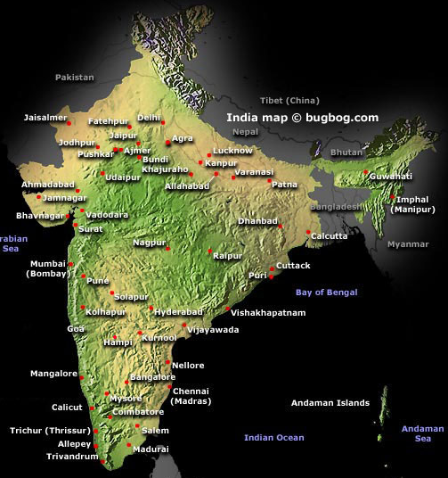



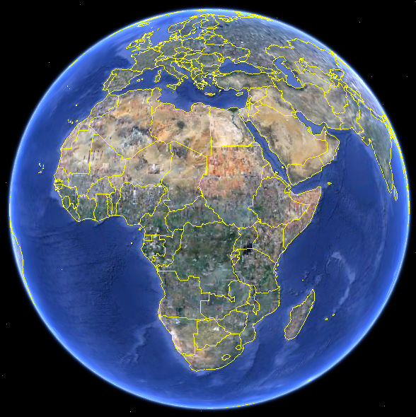





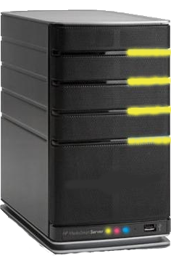

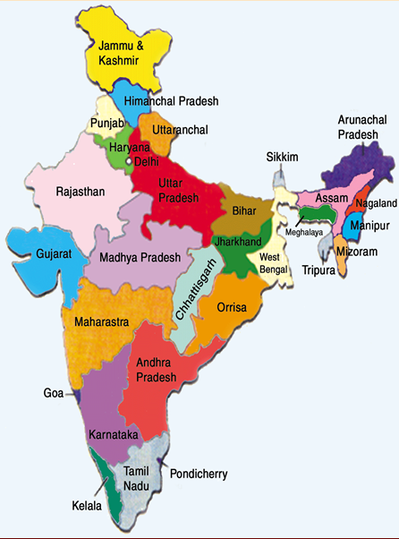
My-Lucy in India
© Copyright 2010, Dominic Foundation - Switzerland

Slide 11
What’s Needed to Start Lucy for Schools and Universities?
National Education System interest in deploying universal access for students with disabilities
Indian IT partner to implement the Lucy platform and deploy dedicated server in India
Key stakeholders participation (educators, content providers, information infrastructure)
Adoption of Assistive Technology standards with special education experts input
Training of the trainers (with on-line tools)

Slide 12
Beyond Edcuation:
Making e-Services Work for All
e-Health
Emergency
e-Gov
e-Edu
e-Skills
e-Office
Multimedia
Entertain.
LucyPC
© Copyright 2010, Dominic Foundation - Switzerland

Slide 13

Thank You !
Questions ?
www.dominic-foundation.org
info@dominic-foundation.org

