Slide 1

Open Source and Proprietary Software… the Need for Interoperability in Accessibility
Mandar Naik
Director – Platform Strategy

Slide 2


















Interoperability
People
The ability of information technology systems, components and services to exchange data and information—“to talk and be understood”
Connecting people, data and diverse systems
  Customers control their data
  Vendors build bridges between systems
One of many ICT features (important)
Semantic
Organizational
Law and Policy
Data
Technical Interop
Applications
Infrastructure

Slide 3
Bridging the software worlds
Open, free and proprietary software
  NO single approach for all customers
  ALL are viable and have their respective strengths
The software industry, and customer environments, are mixed
  For example, OSS on Windows, proprietary on Linux, Windows and Linux in same environment
Customers require industry cooperation, interoperability AND competition
Standards based approach critical to help realize potential

Slide 4








Microsoft’s Commitment To Interoperability
Open engagement
Data portability
Data portability
Support for standards
Interop Executive Customer Council
SugarCRM
Support for standards
Fuji-Xerox
Collaboration
SharePoint Learning Kit
Support for standards
Novell
FPial reports
Yahoo/MSN
Instant Messenger
Open connections to Microsoft products
OpenXML
Quest
Sender ID
OSP
Support for standards
Data portability
44,000 Pages of Protocol Docs
Open connections to Microsoft products
Project Higgins
Open engagement
Document Interop Initiative
Microsoft Interoperability Principles
PHP on Windows
Interop Vendor Alliance
CodePlex
Open Specification Promise
Interoperability Principles
Support for standards
Open XML Translator
Linspire
Standards
Open connections to Microsoft products
Data
portability
OpenPegasus
Open engagement
Internet
Open APIs
EMC
Enterprise Content Management
Open Source Software Lab
Data portability

Slide 5








Cloud services Interoperability
Windows Azure Cloud Platform

Slide 6
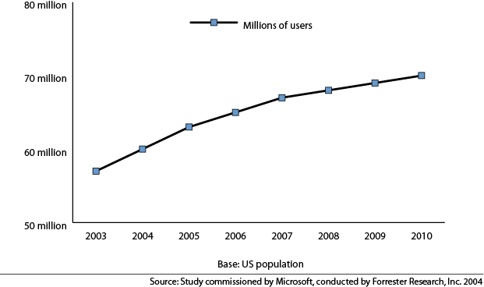
Industry Addressing Growing Need for Assistive Technology
Challenges in meeting the growing need for assistive technologies (AT):
  Lack of common approach across industry to product design
  Products often don’t reflect latest innovative technologies
  Products often not interoperable
Industry stepping up to meet these challenges in a variety of ways
Computer Use by Age and Severity of Difficulties/Impairments

Slide 7















Accessibility Interoperability Alliance (AIA)
Setting industry-wide practices, such as consistent keyboard shortcuts in Web browsers
Improving technical interfaces between AT and IT products
Enabling access to the internet for customers

Slide 8

Save as Daisy
  A free plug-in for Office to convert Open XML documents to DAISY format
  DAISY-formatted files are interoperable with a wide range of devices
  By making a greater range of content accessible, creating opportunities for content providers
“As CEO of the internationally recognized voice of blind and low-vision people around the world and as a reader of DAISY books, I believe this project represents a breakthrough for me both personally and professionally.”
-- Penny Hartin, CEO
World Blind Union.

Slide 9

Microsoft’s User Interface Automation (UIA)
UIA provides a common and simplified approach to developing AT technology
Making the UIA specification available so anyone can use it, free of charge
UIA enables development of interoperable technologies to meet needs of people with one or more disabilities
Collaborating with Novell to make UIA operate on Linux software
Collaborations between Microsoft and Novell are
“tremendous examples of how industry can come together to tackle interoperability problems for blind persons.”
-- Dr. Marc Maurer, President of the National Federation of the Blind.

Slide 10
Summary
Need a “pragmatic” approach – step by step
Focus on Standards is critical
Microsoft is committed to helping meet the needs of customers by:
  Technology innovations
  Working with partners
  Industry-wide collaborations
With the AIA, DAISY, UIA, and other initiatives, Microsoft is working to increase assistive technology through:
  Making selected Microsoft intellectual property broadly and freely available
  Increasing interoperability between AT and IT
  Creating opportunities for others in the industry

Slide 11
Thank You
http://www.microsoft.com/enable/

