Slide 1

Microsoft’s Approach to Accessible Education
EDICT2010
New Delhi, India
October 27-29, 2010
James Thurston
Senior Strategist - Global Policy
Microsoft
Trustworthy Computing Group
Notes:
MGX 2006
01/11/10 12:58:25
© 2006 Microsoft Corporation. All rights reserved.
This presentation is for informational purposes only. Microsoft makes no warranties, express or implied, in this summary.
<number>
Change Title

Slide 2

Our Mission
Help Students and Educators throughout the World Realize their Full Potential
Notes:
<number>

Slide 3
What We’ve Learned
EDU PRIORITIES
EDU GOALS
Creating Jobs and Growth
(78%) 84%
(78%) 84%
(81%) 84%
(81%) 84%
Enabling
Innovation
(79%) 82%
(79%) 82%
(74%) 77%
Transforming Education
(74%) 77%
(67%) 72%
(67%) 72%
(69%) 69%
(69%) 69%
Source: Microsoft EduTracker 2010 (2008)
Notes:
<number>

Slide 4
At Microsoft We Believe
An excellent education is a basic right and a socioeconomic and workforce imperative
Technology can economically accelerate insight and impact at scale
Effective, immersive learning experiences inspire improved outcomes
Communities of committed, collaborative participants are essential to advancing education
Notes:
<number>

Slide 5
Technology for Everyone
  Mobility
  Learning
  Deafness or Hard of Hearing
  Blindness
  Language & Speech
Traditional Disability
  Deafness or Hard of Hearing
  Mobility
  Blindness
Traditional Disability
  Learning
  Language & Speech
  Environmental Factors
  Injury or Surgery
  Repetitive Stress Injury
Temporary Condition
    Noise & Lighting
  Eye Fatigue
    Noise & Lighting
  Environmental Factors
Temporary Condition
  Injury or Surgery
  Repetitive Stress Injury
  Eye Fatigue
  Font Size
    Mouse vs. Stylus
  Input Device
  Simpler User Interface
Customer Preference
  Color Adjustment
    Keyboard vs. Speech
  Color Adjustment
  Simpler User Interface
    Mouse vs. Stylus
  Font Size
Customer Preference
  Input Device
    Keyboard vs. Speech
Notes:
<number>

Slide 6
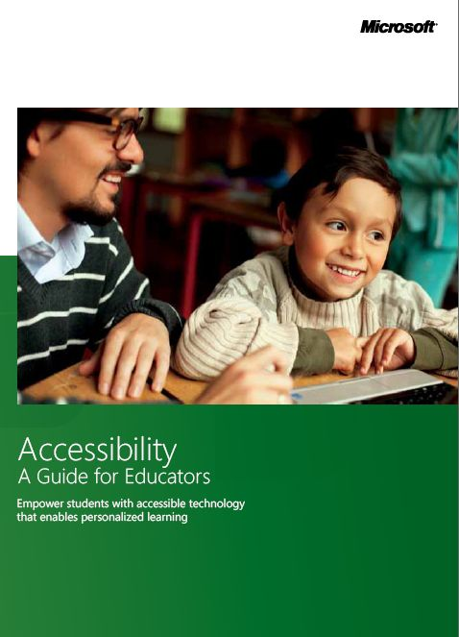
Accessibility: A Guide for Educators
Empowering students with accessible technology that enables personalized learning
3rd edition
Purpose
  Ensure equal access to technology & learning
  Help educators worldwide
How to use the Guide
  Chapter 1 – Personalized Learning & Accessibility
  Chapter 2 – Impairment types & technology solutions
  Chapter 3 – Selecting accessible technology
http://www.microsoft.com/enable/education/
Notes:
<number>

Slide 7
Guide for Educators – Chapter 1
What is accessible technology?
Accessible technology is computer technology which enables
individuals to adjust a computer to meet their visual, hearing,
dexterity, cognitive, and speech needs.
Accessible technology ecosystem encompasses three elements:
Accessibility options built into products such as options that change font size and color, magnifiers, etc.
Assistive technology products which are specialty hardware and software products such as a screen reader or alternate input devices, e.g. sip & puff systems, etc.
Interoperability between assistive technology products, the operating system, and software programs is critical for the assistive technology product to function properly

Slide 8
Guide for Educators – Chapter 1
Personalized Learning & Accessibility
Every child learns in a unique way
Technology is key
There is a need for accessible technology in schools
The Challenge: Inclusive classrooms with equal access for all students
Providing accessible technology is a school responsibility
Enables all students to have the same educational opportunities

Slide 9
Guide for Educators – Chapter 2
Impairment Types & Technology Solutions
Defining disability & impairments
Vision impairments
Learning impairments
Mobility & dexterity impairments
Hearing impairments & deafness
Language impairments
Making the computer easier to see, hear & use
Built-in accessibility features
Assistive technology products

Slide 10
Guide for Educators – Chapter 3
Selecting Accessible Technology
Identifying the right mix of accessibility solutions
Needs assessments
Accessibility consultants - globally
Online training
Assistive Technology product starter guide
Purchasing assistive technology
Assistive technology decision tree
By impairment

Slide 11
For more Information
Microsoft Accessibility Online
www.microsoft.com/enable/
Microsoft Accessibility Update e-Newsletter
www.microsoft.com/enable/news/subscribe/
Microsoft Corporate Citizenship Online
www.microsoft.com/citizenship
Microsoft Software Developer Network (MSDN) Accessibility
http://msdn.microsoft.com/en-us/windows/bb735024.aspx
Notes:
<number>

