Slide 1

ICT for Development
Dr. U.B. Pavanaja
Programme Officer –Indian Languages
Access to Knowledge Program
The Centre for Internet and Society, Bangalore
pavanaja@cis-india.org

Slide 2
ICT4D
Information and Communication Technologies for Development
Use of Information and Communication Technologies (ICTs) for-
  Socioeconomic development
  International development
  Human rights.
More and better information and communication furthers the development of a society.
(from Wikipedia)
Notes:
Tip: Add your own speaker notes here.

Slide 3
ICT
Computers, Laptops, Tablets, Smartphones
Internet
  Email
  World Wide Web
  FTP, Telnet
  IRC
  Discussion groups/Forums
  Chat & VoIP
  Peer-to-Peer (P2P)
  Social Media
Mobile - SMS

Slide 4
Mobile phones and SMS
Mass SMS service
Information dissemination
Timely availability of information
  Fishing, rural farmers
Matrimonial, horoscope, sales, traffic updates…
Medical & agricultural consultancies

Slide 5
Email
Effective communication
Mailing lists
  Topic specific
  Associations, NGOs,
Mailmerge (mass mailing)
eNewsletters

Slide 6
World Wide Web
Collection of websites
Also has these
  Discussions forums
  Social networks
  Blogs
  Microblog
  Chat
Source of information

Slide 7
ICT for Development areas
Livelihood
Education
Health
Weather & Climate
Agriculture
eGovernance

Slide 8
Livelihood
Timely dissemination of vital information
  Latest prices, where to send the produce, govt schemes, change in policies, …
Rural & small enterprises
Small farmers
Microfinance
Poverty Reduction through Informal Employment
  Rural telecenters, Nemmadi

Slide 9

Agriculture
Timely dissemination of vital information
  Latest prices, where to send the produce, govt schemes, change in policies, …
Innovations
  Ex. -remote starting of water pumps
Expert advice
  Crop disease identification & solution
Agricultural value chain
Notes:
The following ICT4D innovation have been found in Taiwan:^{[41]}
A rice germination electronic cooker^{[42]}
A robotic tubing-grafting system for fruit-bearing vegetable seedlings^{[43]}
An air bubble machine and multi-functional, ultrasonic machine for fruit cleaning^{[44]}
India
ASTRA choola
Seeding machine
Remote starting of water pumps
Agricultural value chain
Deciding: At this stage, farmers decide what crop to grow, how much land to allocate for
each crop, and also arrange for financing.
2. Seeding: During this stage, farmers either purchase seeds or prepare their own seeds and
possibly prepare a seed bed.
3. Preparing and planting: During this stage, there is land preparation using labour or
machines and actual planting happens.
4. Growing: At this stage, applying fertilizer, pesticides and water takes place.
5. Harvesting, packing and storing: During this stage, finding labour for harvesting,
finding storage and packing are the main activities.
6. Selling: In the final stage, (some) farmers check prices at the market, find a transportation
method, and transport the packed produce to the market and sell it.
A system of advisory services in India delivered by mobile phones whereby farmers were able to access information related to
crop and nutrient practices to improve their yields. This information, tailored to the needs of 450 farmers in the villages of Sirkali Taluk, Nagapattinam District, India, helped them increase their income by 15 percent

Slide 10
Health
Medical (symptoms, disease & medicine) database
Drug database (effects, side effects, alternates)
Medical & health related apps
Telemedicine
Remote assistance in operations
Medical & health related gadgets

Slide 11
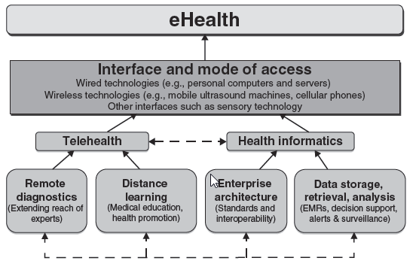
eHealth

Slide 12
Weather & Climate
Weather information & forecast
  Helps fishing, farming,..
Weather forecasting, cyclone warning
  Disaster management

Slide 13
ICT for Education
Technology for education, technology enabled learning
OLPC
Teachers’ training, train the trainer
Online encyclopaedias, learning materials, tutorials, courses
Tablets & content for them
Details of courses, submitting applications online
Online entrance examinations

Slide 14
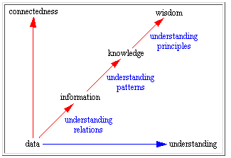
Education
Technology for education

Slide 15
E-Learning
All forms of electronic supported learning and teaching, which are procedural in character and aim to effect the construction of knowledge with reference to individual experience, practice and knowledge of the learner.
Includes Web-based learning, computer-based learning, virtual classrooms and digital collaboration.
Content delivered via the Internet, intranet, satellite TV, CD/DVD/USB drive…
Synonyms -CBT (Computer-Based Training), IBT (Internet-Based Training), WBT (Web-Based Training), CBL (Computer-Based Learning), CBI (Computer-Based Instruction), CBE (Computer-Based Education)
Technology for education

Slide 16
Using multimedia in Education
Multimedia consists of Text, Graphics, Audio, Animation, Video
Interactive
Individualized learning
Can explain many things which are otherwise not possible –
  Ex., functioning of heart, internal combustion engine, planetary motions
Edutainment
Complementary to conventional education
Technology for education

Slide 17
Benefits of E-Learning
Can act as individual tutor
Can fascinate while they teach
Can teach students of a diverse nature
Can repeat a lesson any number of times, without getting angry, till the student learns
Can give a better education for slower students
Bright students will probably reap the most impressive gains
Will eliminate bias and prejudice in teaching
Will eliminate punishments
Equal opportunity for underprivileged children
Student can study whenever he/she has the time
Technology for education

Slide 18
Technology in classroom
What
Wired classroom
PC + projector for the teacher
One PC per student –best situation
Connected Instruments, gadgets, sensors
Internet connection
How
Student centric
Facilitated by the teacher
Collaborative
Activity based learning
Technology for education

Slide 19
Learning Cycle Structure
Remedial & reinforcement through Summative & Formative Assessments, Feedback, Portfolio Based Assessment, Peer & Self Assessment
Knowledge & Understanding Through Standardized Lesson Plans creating using Digital Curriculum Content repository And IBook
LMS
Experience
Extend
Evaluate
Engage
Higher Order Application & Synthesis Through Activities, Peer Learning, Projects, High stake preparations
Verification and Application Through Concrete Physical Objects , Gadgets, Manipulative and Software Tools
Technology for education

Slide 20
Learning Management System
Content – Text, Audio, Video, Animation, Presentation slides, etc.
Hierarchically organized –Institute, Course, Subject, Topic/Chapter/Unit
Organized as per Learning Objects
Different Logins-
  University/Board
  College/School Administrator
  Teacher
  Student
Progress tracking
Technology for education

Slide 21
ICT Enabled Learning benefits
For students
For teachers
A vibrant learner-friendly environment
Convenience of access
Easy to use tools of learning
Better understanding of concepts and their application that is further augmented by face to face interaction within the classroom
Improves the quality and consistency of education delivered
Interaction with students beyond classroom
Tracking students’ activity & progress
Access to content, resources
Technology for education

Slide 22
Paradigm shift
Teacher
Student
Facilitator
Learner
Technology for education

Slide 23
eGovernance
Delivering government services
Exchange of information communication transactions
Government-to-Citizens (G2C)
Government-to-Business (G2B)
Government-to-Government (G2G)
Back office processes
Internal communications & flow of information

Slide 24
eGovernance examples
Online registrations of birth, death, marriage
Healthcare, educational services
Online filing of income tax
Online complaint registrations
Online tenders
Downloading forms
Voter registration

Slide 25
eGovernance benefits
Fast & easy services
Increased accountability
Increased transparency
Reduced corruption
Increased efficiency due to connectivity
Timesaving

Slide 26
Challenges
Connectivity at rural places
Erratic power supply
Indian language support on devices
  Lack of support in some devices
  Lack of awareness

Slide 27
Resources
www.idrc.ca/EN/Resources/Publications/Collections/ICT4D/Pages/default.aspx
idl-bnc.idrc.ca/dspace/bitstream/10625/52228/1/IDL-52228.pdf

Slide 28
Questions?

Slide 29
Thank you!

