Slide 1

Scalability and Security Issues in Distributed Trust based Crypto-Currency Systems like BITCOIN
Sharath Chandra Ram sharath@cis-india.org

Slide 2

The Byzantine General’s Problem –
Fault/MisTrust Tolerance in Distributed Computation

Slide 3
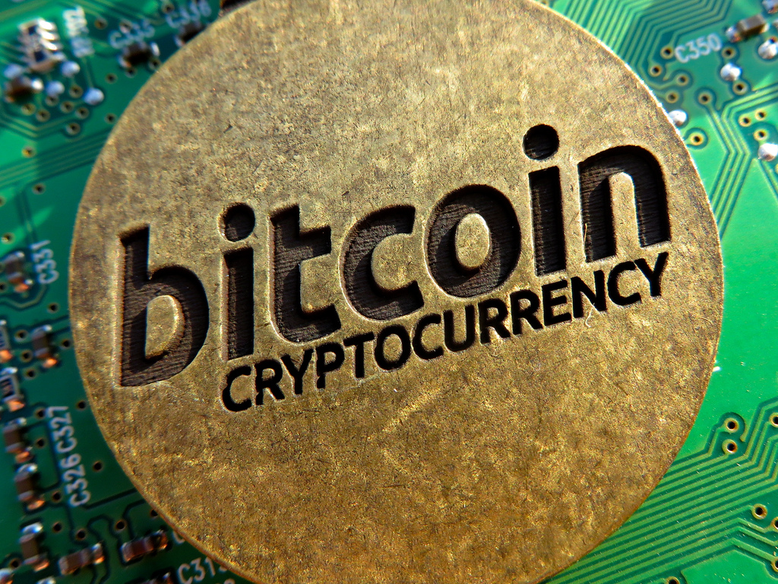
Bitcoin/Cryptocurrency in many ways is analogous to the Internet of money:
a network for propagating value
securing ownership of digital assets via distributed computation.
And all this is an innately trust-based, insecure and potentially vulnerable environment.

Slide 4
Traditional Paper Currency Vs Digital Crypto Money
Concerns when dealing with any sort of currency –
And How a decentralized network is essential for
secure crypto-currency :
Can I trust the money is authentic and not counterfeit?
Can I be sure that no one else can claim that this money
belongs to them and not me? ( “double-spend” problem)

Slide 5
The Byzantine Generals’ Problem
Communicating only by messenger, the generals must agree upon a common battle plan. However, one or more of them may be traitors who will try to confuse the others.
The problem : To find an algorithm to ensure that loyal generals will reach a the desired agreement.

Slide 6
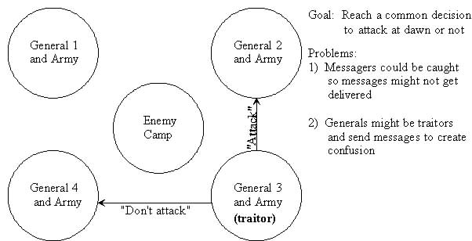

Slide 7
REFLECTIONS/SOLUTIONS to the BYZANTINE GENERAL’s PROBLEM that influence Design of the BITCOIN Distributed Computation System:
Using only oral messages, this problem is solvable if and only if more than two-thirds of the generals are loyal; so a single traitor can confound two loyal generals. (Temporality of messages and the ability to misquote)
With unforgeable written messages, the problem is solvable for any number of generals and possible traitors.

Slide 8
Ultimately all Fault Tolerant strategies share a common strategy >>>>>>>>>>
Redundancy
A Misplaced House-Keys Situation needs Duplicate Keys
A Flat Tyre Situation relies on the redundant Stepney
And in fault tolerant Software Design, Redundancy takes the form of ---------→

Slide 9

And for fault tolerant Software Design, Redundancy takes
the form of … DATA REPLICATION !!

Slide 10
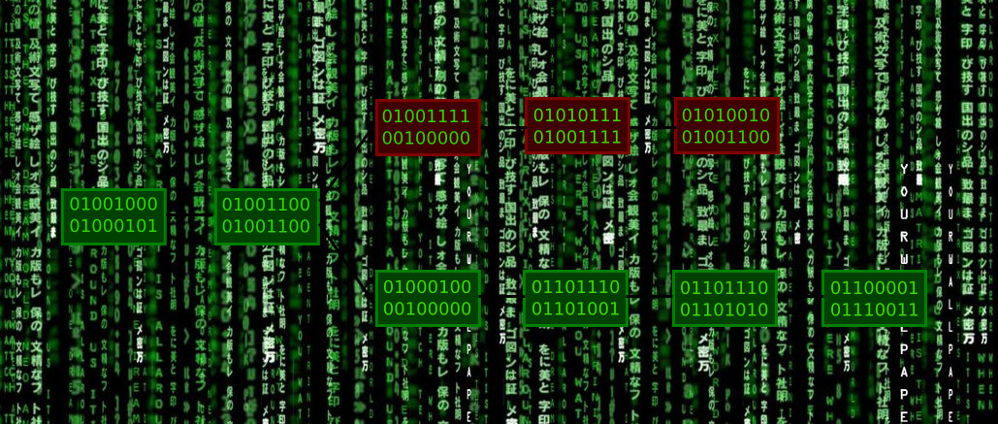
This leads to a SCALABILITY ISSUE in BITCOIN P2P NETWORK to MAINTAIN DISTRIBUTED TRUST
Every Peer in the Bitcoin network maintains the ‘ledger’ (blockchain) for all transactions that have occurred network . This today amounts to a whopping 33GB of Hard Drive Space and is growing. (Cost of memory/computation related to value of mining bitcoins? – An Elegant problem yet unsolved – Maxwell’s Demon and the elemental Thermodynamics of Computation)

Slide 11
A de-centralized peer-to-peer network (the bitcoin protocol);
A public transaction ledger (the blockchain);
A de-centralized mathematical and deterministic currency issuance (distributed mining),
A de-centralized transaction verification system (transaction script)

Slide 12
RISK Modeling - CLIENT INTERFACE PARADIGMS for BITCOIN SERVICES
Full Client
A full client, or “full node” is a client that stores the entire history of bitcoin transactions, manages the user’s wallets and can initiate transactions directly on the bitcoin network. This is similar to a standalone email server, in that it handles all aspects of the protocol without relying on any other servers or third party services.
Light Client
A lightweight client stores the user’s wallet but relies on third-party owned servers for access to the bitcoin transactions and network. The light client does not store a full copy of all transactions and therefore must trust the third party servers for transaction validation. This is similar to a standalone email client that connects to a mail server for access to a mailbox, in that it relies on a third party for interactions with the network.
Web Client
Web-clients are accessed through a web browser and store the user’s wallet on a server owned by a
third party. This is similar to webmail, in that it relies entirely on a third party server.

Slide 13
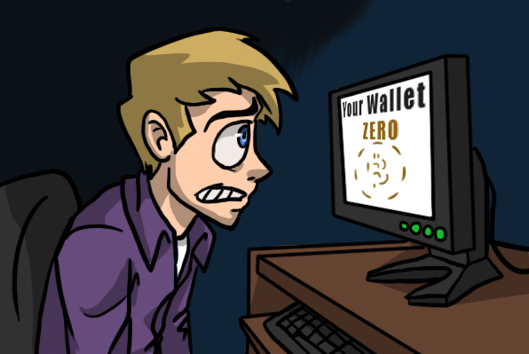
Mass theft of cryptocurrency is usually accomplished through :
Hacking of exchanges or marketplaces. (well-publicized Thefts, and the total number of stolen coins is known.)
Individual users' wallets or exchange accounts via malware:
a)general-purpose remote access trojans (RATs)
b)specialized cryptocurrency-stealing malware
(CCSM).

Slide 14

The Curious Case of MT GOX
Mt Gox handled 70% of total Bitcoin Transactions as of 2013.
Mt Gox announced that around 850,000 bitcoins belonging to customers and the company were missing and likely stolen( $450 million at the time.)
Mt Gox claimed that 200,000 bitcoins had been "found" without citing proof/reason for the disappearance—theft, fraud, mismanagement, or a combination of these?

Slide 15
In September of 2012, $250,000 worth of BTCs were stolen from an American exchange called Bitfloor.

Slide 16
Mass theft of cryptocurrency is usually accomplished through :
Hacking of exchanges or marketplaces. (well-publicized Thefts, and the total number of stolen coins is known.)
Individual users' wallets or exchange accounts via malware:
a)general-purpose remote access trojans (RATs)
b)specialized cryptocurrency-stealing malware
(CCSM).

Slide 17

Crypto Currency Stealing Malware
(CCSM) Types :
Wallet Thief (The Lowly Pickpocket) :
Searches for "wallet.dat" or other well-known wallet software key storage locations
File is uploaded to a remote FTP, HTTP, or SMTP server where the thief can extract the keys, steal the coins by signing a transaction and finally transferring the coins to the thief's Bitcoin/altcoin address.
Keylogger/Clipboard monitors to retrieve passphrase that users employ for additional security to their hard drives.

Slide 18
Crypto Currency Stealing Malware
(CCSM) Types :
2) CREDENTIAL STEALING
( BIT COIN Exchanges and Scenarios from Traditional Internet Banking Vulnerabilities)
CLAIMS : Many exchanges have implemented two-factor authentication (2FA) using one-time PINs (OTP) to combat unauthorized account logins.
Advanced malware can easily bypass OTP-based 2FA by intercepting the OTP as it is used
Create a second hidden browser window to log the thief into the account from the victim's computer.
Simultaneously, the malware displays a fake "authentication failed" message, blocks the victim's access to the website while the thief empties the account

Slide 19
Crypto Currency Stealing Malware
(CCSM) Types :
Remote Procedure Call Vulnerability :
Bitcoin "reference client" software includes remote procedure call (RPC) functionality, which allows another program to interact with the wallet software. In many cases, a thief with access to this functionality could connect to a running client on a local TCP port and steal the balance of an unencrypted wallet using only two commands (three if the wallet is encrypted and the malware has obtained the passphrase).

Slide 20
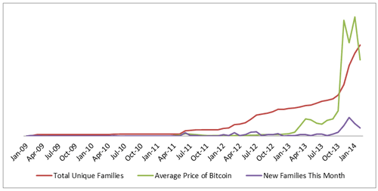
The correlation between Bitcoin price, new malware emergence and total threat of
cryptocurrency-stealing malware. (Source: Dell SecureWorks)

Slide 21
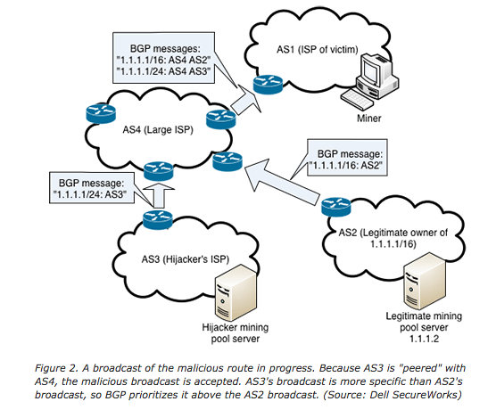
Re-visiting the BGP vulnerability Exploit used to redirect BITCOIN Mining pool in March 2014 to make $83,000 is 4 months , by an anonymous Hijacker later pinpointed to Canada

Slide 22
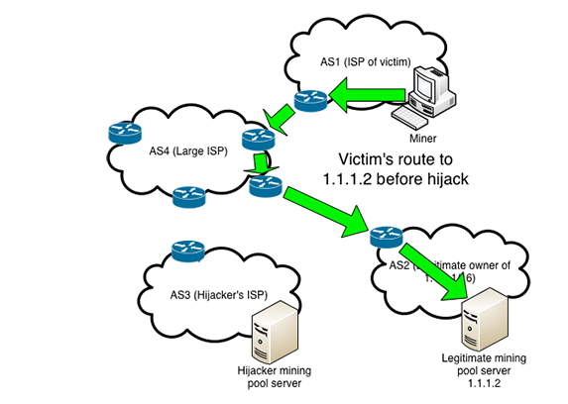

Slide 23
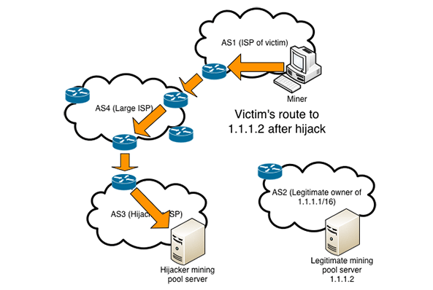

Slide 24
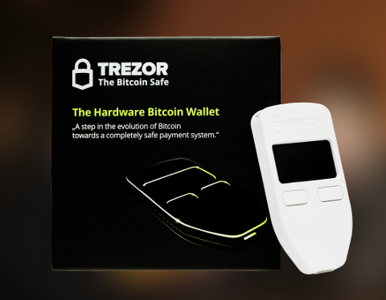
Rise of Secure Hardware Crypto- Wallets and Issues of Openness, Trust and Piracy.

Slide 25
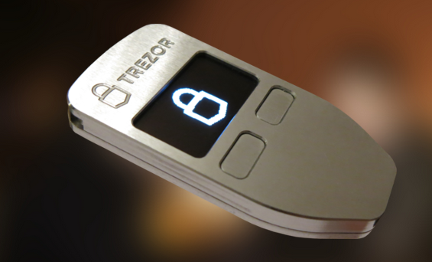
How can you ensure that SatoshiLabs isn't going to use some backdoor on the Trezor/ (or for that matter newer hardware wallet entrants in the market) to steal your bitcoin private keys?

Slide 26
Solution 1 : Open Source Software –
Trezor’s Bootloader Code Released on GITHUB
Great! But how do I know if my hardware wallet runs the same firmware and code it is supposed to and not a modified version/trojan?

Slide 27
Compare the checksum of actual device firmware and released code.
If a proper hash function is used, like SHA256, The probability of altered code having the same hash is around 2⁻²⁵⁶ for SHA256.
And yet cannot rule out trojans which looks for specific locations in the code to get called and then read the keys. Essentially a malicious hypervisor. There are methods to extract keys from all possible firmware.

Slide 28
HARDWARE TROJANS
Inserted into FPGA NETLIST during manufacturing
Usually done at point of manufacture at CHIP LEVEL
Many instances of Hardware Trojan backdoors in popular consumer electronic devices likeImitation Iphones/Android Phones manufactured in China.

Slide 29
SOLUTIONS :
Open Source Software and Hardware
ISSUES :
Specialized Level of User Skill/Transfer of Trust to 3rd party Vendors

Slide 30
DISCUSSION :
Open Standards like Bitcoin need Openness in Implementation (Hardware/Software) to ensure Security Best Practices
Educate users about Privacy and Cybersecurity issues/ use of FOSS/ Technical Skills/Tools/Training
Cryptography Auditors/Audited Crypto Release is essential
Risk Modelling /Data Protection/ Disclaimers for Bitcon Exchanges not strong enough yet
WORK IN PROGRESS

Slide 31
Scalability and Security Issues in Distributed Trust based Crypto-Currency Systems/ BITCOIN
Sharath Chandra Ram sharath@cis-india.org
THANK YOU

